Slide 1
Endometrial Cancer
Erika Li, Tomas Manea, Nathan Yoon
QBIO 490

Slide 2
Review Paper:
Endometrial cancer - Crosbie et al., 2022

Slide 3
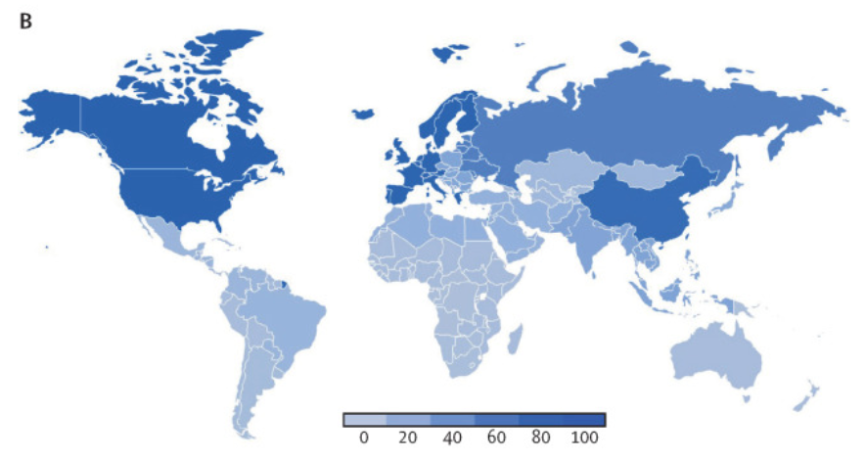
Endometrial Cancer: A Review
3%- lifetime risk
Largely sourced from genomic data.
Most common gynecological cancer in high-income countries
Incidence is rising globally (up 132% in last 30 years)
6th most common cancer among women
2020 - 417,000 diagnoses
USA - blacks are more likely to develop tumors over whites
Figure 1B. Age-standardized incidence rate of endometrial cancer 2019 (100 000 population) per GBD region. Crosbie et al., 2022.

Slide 4
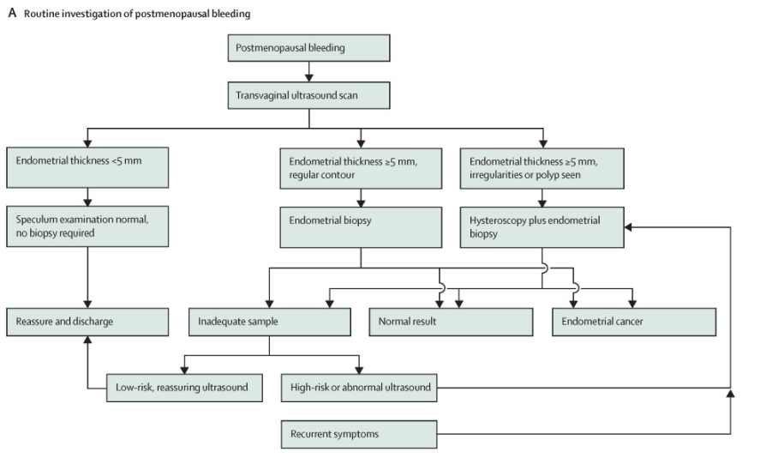
How do we spot endometrial cancer?
“It’s complicated”
Postmenopausal bleeding - probability of cancer increases with age
Diagnosis requires tissue exam
EM thickness >= 5 mm indicates potential for cancer
Figure 2A. Current diagnostic pathways for endometrial cancer. Crosbie et al., 2022.

Slide 5
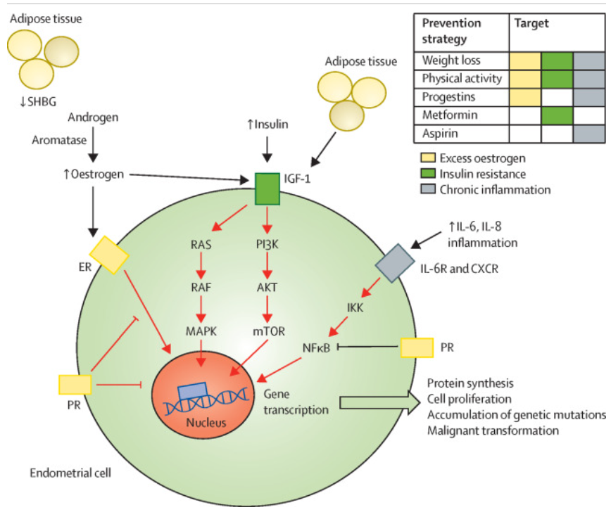
Risk Factors
Risk increases with AGE and BMI - cancer with the strongest link with obesity
BMI > 40: 10-15% chance of cancer ~ lung cancer in smokers
Obesity -> high CRP, IL-6, TNF-alpha -> endometrial formation +
Estrogen - EM growth, progesterone - EM in check
Post-menopause - progesterone deficiency
Figure 3. Obesity-associated endometrial cancer: pathways to carcinogenesis and targets for prevention. Crosbie et al., 2022.

Slide 6
Surgery and Treatment
Current mainstay of treatment: total hysterectomy + bilateral salpingo-oophorectomy
Minimally invasive surgery shown to have non-inferior outcomes. Preferred whenever possible
Fertility-sparing treatment? Currently not very great
Oncological recurrence ~35% after treatment
Pregnancy prospects ~27%
Weight loss leads to both less cardiovascular disease and increased endometrial cancer survival rate

Slide 7
Research Paper:
Analysis of endometrial carcinoma TCGA reveals differences in DNA methylation in tumors from Black and White women - Asif et al., 2023

Slide 8
Introduction
Racial disparities
Tumor subtypes
Mortality rates
Social determinants of health
Impacts on epigenetic alterations, such as DNA methylation
Epigenetic modifications contribute to endometrial carcinogenesis
Global hypomethylation
Hypermethylation at CpGs in promoter regions
Result: oncogene activation, tumor suppressor inhibition, genomic instability
Notes:
Black women tend to have more aggressive endometrial tumor subtypes
Black women are two times more likely to die of endometrial carcinoma, despite the fact that white women have the highest incidence rate of endometrial cancer of all race groups.
Social determinants of health: diet, education, healthcare access, physical environment
DNA methylation: when methyl groups attach to DNA, activating or repressing genes
High levels of methylation at cytosine-guanine dinucleotides
Genomic instability: increased likelihood of genome alteration during cell division

Slide 9
Gap in knowledge/hypothesis
Given that there are significant racial disparities in endometrial carcinoma, and the relationship between social determinants of health and epigenetic alterations, could there be epigenetic differences in endometrial cancer between Black and White women?

Slide 10
Methods
-Omics: Epigenomics and Transcriptomics
Downloaded endometrial carcinoma methylation and clinical data from TCGA
46 normal tissues and 439 tumor samples
Parsed by race, leaving 393 samples
294 White samples, 99 Black samples
Differentially methylated CpGs were identified using Limma package in R
Differentially methylated regions were identified with DMRcate
Survival analysis generated with survival R package
Correlation analysis between changes in methylation and gene expression
Enrichment analysis
Notes:
EPIGENOMICS + TRANSCRIPTOMICS!!!

Slide 11
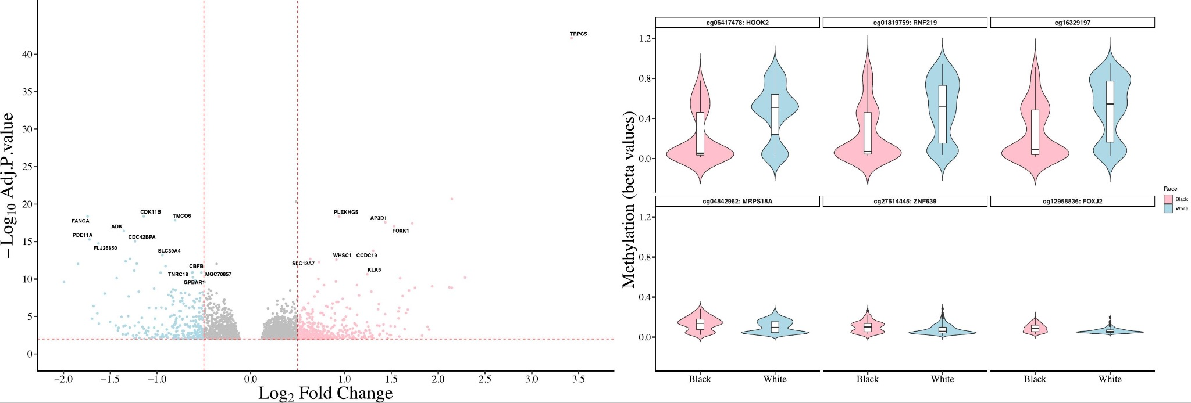
Results
DMC’s Analysis
Fig 1A. Volcano plot for differentially methylated CpGs (DMCs) in tumors from White vs Black patients. Asif et al., 2023
2. DMC’s Analysis
Fig 1B. Violin plot of six significant differentiated methylated CpGs (DMCs) between White and Black tumors. Asif et al., 2023
Notes:
Text: “Results were consolidated into a variety of analysis—DVC gene enrichment, Cox-proportional hazard regression, computational text-mining, and gene manual inspection. Differentially methylated CpGs. Of 704 CpGs, 432 DMC were hypermethylated Vs. 272 that were hypomethylated in white tumor samples. The majority of these DMCs were found in CpG islands (71%) followed by open sea (greater then 4 k from CpG islands, 44%) and south shore (<2 kb downstream of CpG islands, 20%).
Fig 1A. The x axis represents the log fold change and y axis represent –log10 false discovery rate (FDR) adjusted P values. Significance thresholds are shown by red dotted lines (FDR adj p value = 0.01 (−log10(0.01) = 2) and absolute log fold change greater than and equal to 0.5). A total of 704 differentially methylated CpGs (DMCs) were found. Pink dots indicate hypermethylated CpGs in White tumor samples compared to Black tumor samples (total 432) while blue dots represent hypermethylated CpGs in Black relative to White tumor samples (total 272). Insignificant CpGs are shown in grey. Overall, more CpGs hypomethylated in Black tumor samples (61.5% in Black vs 38% in White tumor samples) was observed.
Fig 1B. Top. CpG sites cg06417478, cg01819759, cg1639197 were hypermethylated and bottom cg04842962, cg27614445, cg12958836 were hypomethylated in tumors of White compared to Black patients. The line in the center represents average methylation in each group. Pink colour is showing CpG sites in Black tumor samples and light blue is for White tumor samples. (For interpretation of the references to colour in this figure legend, the reader is referred to the web version of this article.)

Slide 12
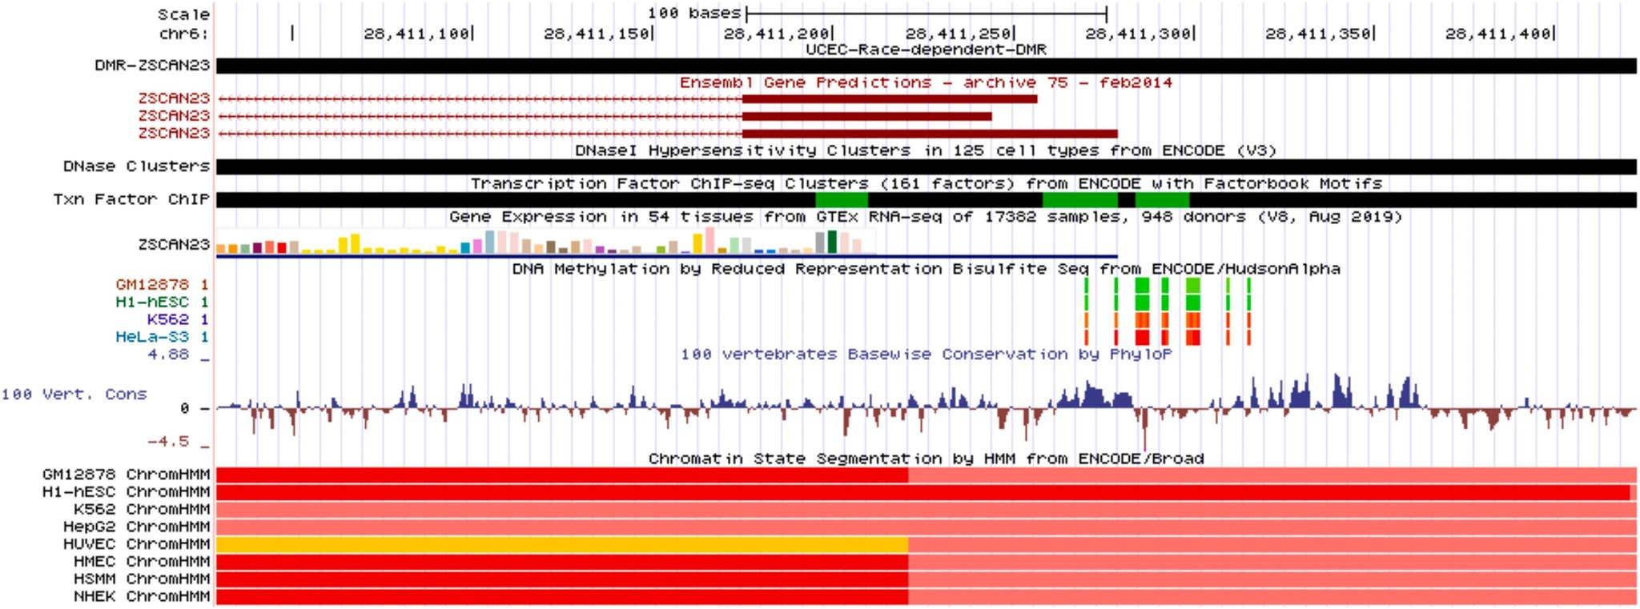
Results Contin.
3.
Visualization of DMR using UCSC Genome Browser
Fig 2. Visualization of DMR using UCSC Genome Browser. Asif et al., 2023
Notes:
Of 395 regions, 228 hypermethylated DMRs and 167 hypomethylated DMRs, were found in tumors from white women.
Researchers randomly selected one of the DMR that overlapped ZSCAN23 gene for manual inspection and compared it with multiple data resources in UCSC Genome Browser.
DMR is enriched in Dnase I Hypersensitive sites (DHS), transcription factor binding sites (TFBSs) and enhancers, which further highlight the functional importance of this region.
To explore the location and functional relevance of DMRs, one of the DMR-ZSCAN23 is plotted using multiple data resources such as Transcription factor binding site, Gene annotation, DNA-methylation, Chromatin states, and conservation annotation tracks.
Functional regions based on ChromHMM defined chromatin state segmentation showed that this DMR is covered by enhancer, active and weak promoter (Indicated by yellow, red and light red colors), which therefore highlights the functional importance of this DMR.

Slide 13
Discussion
Hyper & -Hypomethylation is key in cancer studies
Racial disparities in cancer incidence
Selected Genes—in insulin signaling pathway—demonstrated twice as hypervariable
Notes:
DVC gene enrichment, Cox-proportional hazard regression, computational text-mining, and gene manual inspection.
Gene promoter hyper/hypomethylation is key in cancer studies
Linked with racial disparities in cancer incidence and mortality rounds out the epigenetic regulation of cancer-associated genes
Overall survival analysis using Cox-proportional hazard regression model stratified by race and aggressive endometrial tumors showed worse survival in black women than white (Median: 1249 vs 2352 days)
Selected Genes—in insulin signaling pathway—demonstrated twice as hypervariable in Black than White tumor samples
Pathway analysis showed that hypervariable genes were enriched in insulin signaling pathway in obese black tumor samples only. In addition, Gene ontology (GO) enrichment analysis of hypervariable genes in obese tumor samples showed insulin signaling pathway or insulin related terms only in black tumors (Fig. S4; Table S3, S4). These finding based on DVCs are in line with previous studies that showed increased insulin level in obese black women are linked with histological types of differences in endometrial cancer

Slide 14
Questions/Future Directions
What factors and processes are contributing to these differences in methylation between Black and White women with endometrial carcinoma?
Future in vitro studies could help answer this question
How can the discovery of differential methylation in Black and White endometrial carcinoma patients contribute to the development of new methods of diagnosis or therapeutics?
The review paper has shown that age and BMI impact likelihood for cancer. Is there a significant socioeconomic difference which contributes to different cancer incidence rates between Blacks and Whites in the U.S.?

Slide 15
Works Cited
Asif, H., Foley, G., Simon, M., Roque, D., & Kim, J. J. (2023). Analysis of endometrial carcinoma TCGA reveals differences in DNA methylation in tumors from Black and White women. Gynecologic Oncology, 170, 1-10. https://doi.org/10.1016/j.ygyno.2022.12.011.
Crosbie, E. J., Kitson, S. J., McAlpine, J. N., Mukhopadhyay, A., Powell, M. E., & Singh, N. (2022). Endometrial cancer. The Lancet, 399(10333), 1412-1428.

